Slide 1




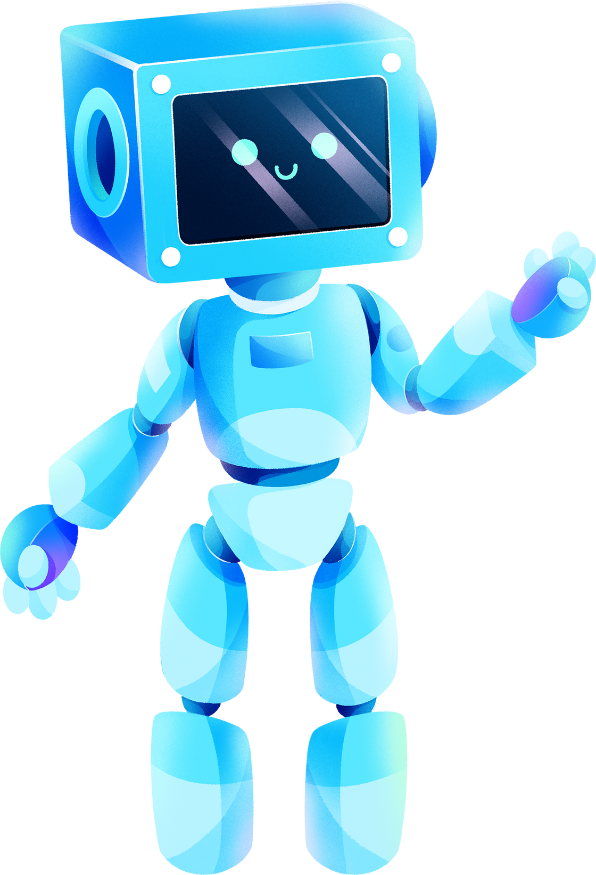

SMART MIRROR
PROJECT
FINAL PRESENTATION
THE QUANTUM ALCHEMISTS :
Dagmawi Abera
Hamede Abdulgafur
Noah Awol

Slide 2
TABLE OF CONTENTS
Introduction to the Smart Mirror Project
System Level drawing/ Block Diagram
Technical Details
Final Results and Achievements
Problem Faced and Overcome
Current and Future Work
Updated Gantt Chart

Slide 3

INTRODUCTION TO THE SMART MIRROR PROJECT
Context and Overview
In today's digital era, there's a growing need to enhance everyday objects with technology. The Smart Mirror project transforms the traditional home mirror into an interactive device, merging aesthetics with functionality. This advanced mirror displays real-time information like weather, news, and calendar events, and personalizes content for individual users.
Goals of the Smart Mirror
Functionality: Enhance mirrors to display relevant real-time information seamlessly.
Personalization: Enable custom profiles to cater to individual user preferences.
User Experience: Offer an intuitive interface that simplifies access to desired information with minimal interaction.
Implementation Strategy
Our strategy involves integrating a high-definition display and sensors into a two-way mirror, developing user-friendly software that pulls real-time data.

Slide 4
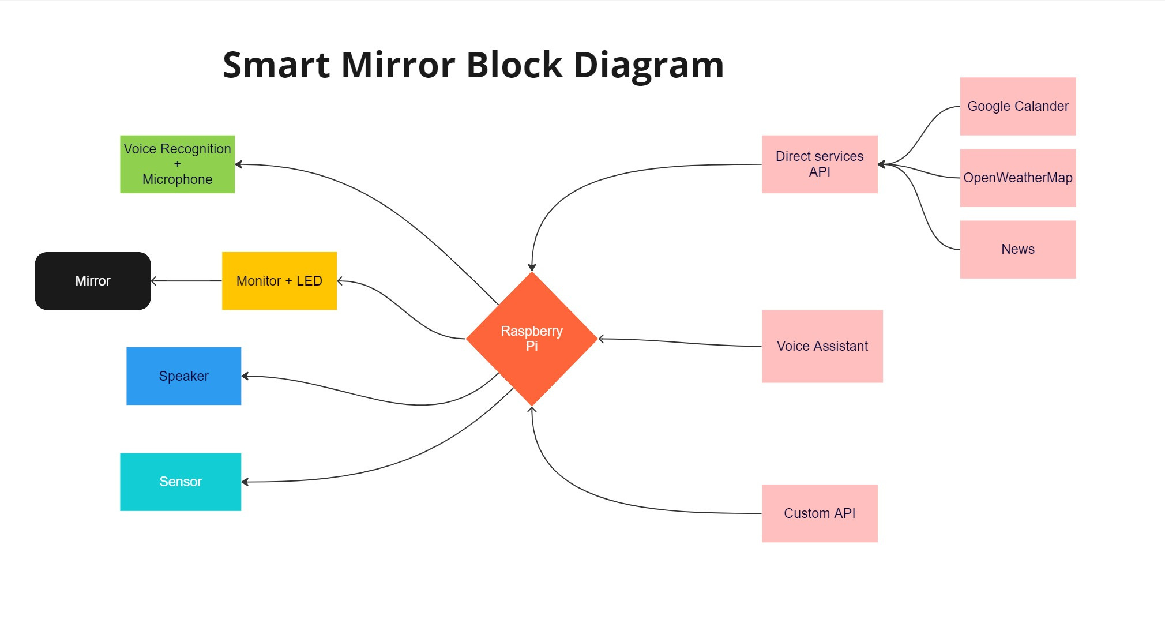

Slide 5
TECHNICAL DETAILS
Magic Mirror Platform: We used Magic Mirror², an adaptable open-source platform that allows for extensive customization through modular additions.
Custom Software Modules:
Spotify Integration: Developed a custom module to integrate Spotify using its API, enabling direct music streaming and user interaction within the mirror interface.
PIR Sensor Management: Custom script written to interface with the PIR motion sensor, managing the display's power state by turning it off during inactivity and reactivating upon motion detection.
Voice Command Integration: Integrated Google Assistant via a mini microphone setup, allowing for voice-controlled interactions and responses, enhancing user convenience.
User Interface Enhancements:
Implemented interactive features such as real-time news updates, weather forecasts, and personal greetings, each through respective modules that fetch and display dynamic content based on user preferences and environmental data.

Slide 6



FINAL RESULTS AND ACHIEVEMENTS
Successful Hardware Integration: Overcoming initial challenges, our team, Dagmawi and Noah, successfully integrated all hardware components essential to our project's foundation.
Software Development Completion: Under the leadership of Hamede Abdulgafur, we completed the integration of crucial software modules, ensuring a seamless and functional application environment.
Enhanced Display Environment for Smart Mirror: Our Smart Mirror now boasts a comprehensive display environment designed to enhance daily routines. Key features include:
Google Calendar integration
Personalized greetings and compliments
Access to recent news
Displays of current time and weather
Future weather forecasts
Spotify integration with custom API for music streaming

Slide 7
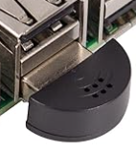
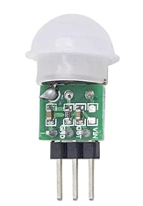
FINAL RESULTS AND ACHIEVEMENTS
New Sensor and Audio Implementations:
PIR Body Motion Sensor: We've added a PIR Body Motion Sensor, enhancing user interaction by detecting presence effectively. We've set a threshold of 2 minutes; if no motion is detected within this time, the display will automatically turn off. The display will reactivate once motion is detected again.
Mini Microphone for Raspberry Pi: Integration of a mini microphone has been successful, enabling voice commands and interactions.
Speaker Functionality: After addressing an initial issue where the speaker wire was connected inversely to the motherboard of the display monitor, our speaker is now fully operational. We confirmed that both Google Assistant responses and Spotify streaming are working flawlessly
Microphone
MINI PIR Motion sensor

Slide 8
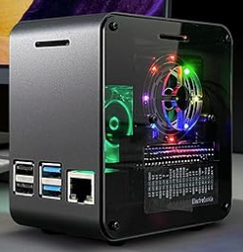
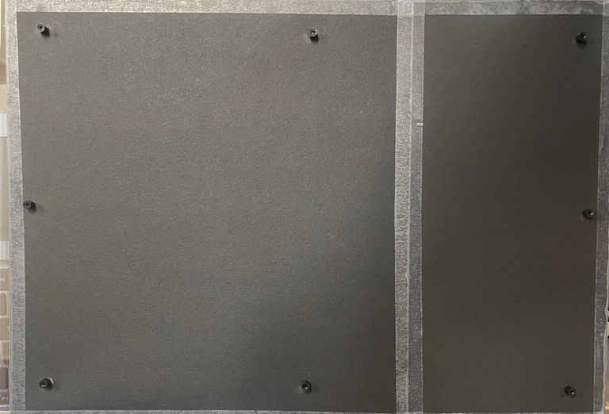
FINAL RESULTS AND ACHIEVEMENTS
Enhancements in Hardware Management:
Raspberry Pi Case with Cooling Fan: we purchased a case equipped with a cooling fan for our Raspberry Pi. This decision ensures that the device remains cool and functional, as it operates continuously within our Smart Mirror setup.
Aesthetic and Protective Covering: To enhance the visual appeal and protect the internal components, we've covered the back of our Smart Mirror with a black sheet. This not only improves the aesthetic but also conceals the inner workings, ensuring a sleek and tidy appearance.

Slide 9
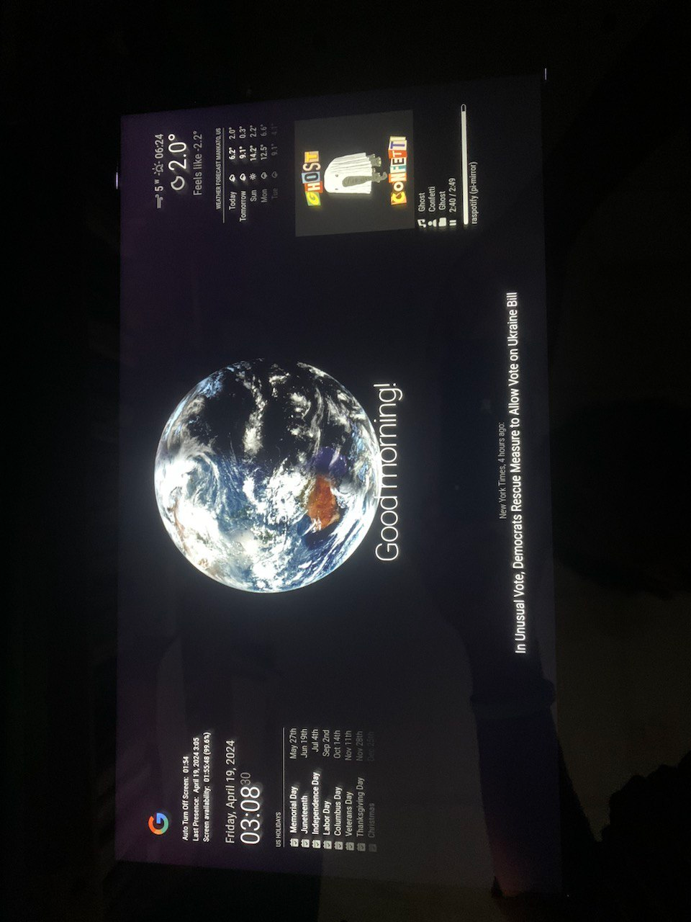

Slide 10
FUTURE DIRECTIONS AND FURTHER IMPROVMENTS
Motion Sensor Placement: Plan to embed the PIR motion sensor directly behind the mirror for improved responsiveness and a cleaner design.
Advanced Voice Interaction: Enhance voice command capabilities with more sophisticated processing for complex interactions.
User Customization: Develop an interface for personalized settings, allowing users to adjust display and module preferences.
Health and Wellness Modules: Integrate health-focused features to provide reminders and fitness tracking directly on the mirror.
Energy Management: Implement smarter protocols to optimize energy use based on user habits and environmental cues.

Slide 11
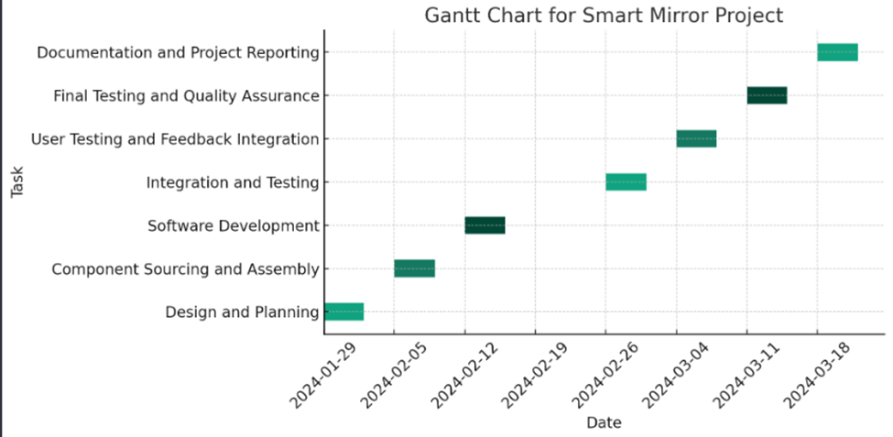




UPDATED GANTT CHART
Yes

Slide 12
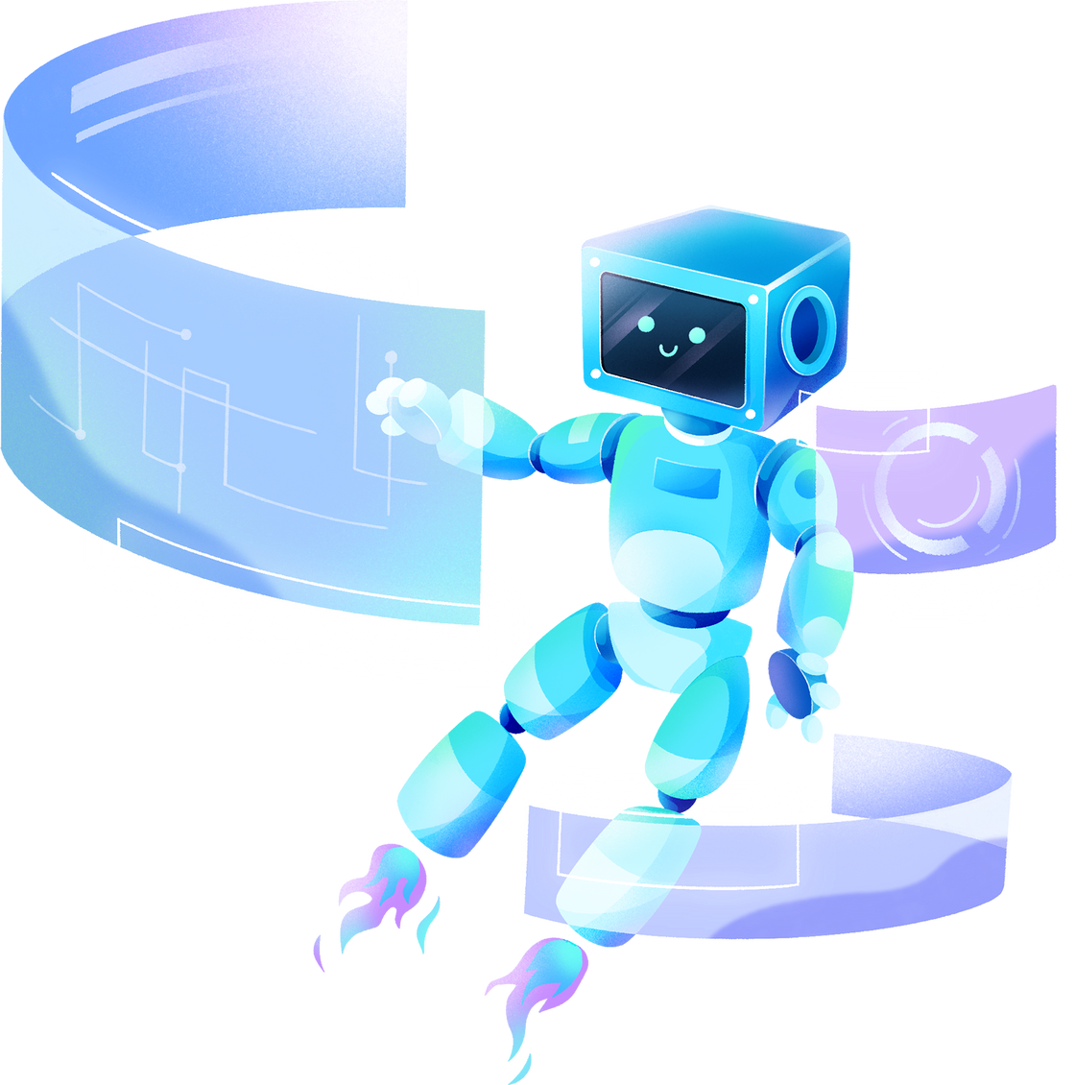
THANK YOU!

